Slide 1
HOTEL RATING CLASSIFICATION
Mentor: Karthik Muskula
BY GROUP 3:
Bhargava Venkata Satya Sai
Deepak Kumar Tiwari
Bala Vara Lakshmi
Danish Mohammed
Yash vardhan Hanumanth
Hitendra Panchal
Abhi Raj
EXCELR
Raising Excellence

Slide 2
Business Objective
Business Objective, Understanding and Approach
The dataset which consists of 20,000 reviews and ratings for different hotels and our goal is to examine how travelers are communicating their positive and negative experiences in online platforms for staying in a specific hotel .
major objective is what are the attributes that travelers are considering while selecting a hotel. With this manager can understand which elements of their hotel influence more in forming a positive review or improves hotel brand image.
Understanding and Approach
In this project, sentiment analysis is performed on the basis of user reviews using three diﬀerent classiﬁers.
The classiﬁers used in this project are “Naive Bayes", "Random Forest” and “Support Vector Machine”.
The performance of these algorithms are assessed on two diﬀerent parametersettings.
The reviews are classiﬁed as “positive", "negative” labels.

Slide 3
PR0JECT ARCHITECTURE/FLOW
BUSINESS UNDERSTANDING
Test data
Model Evaluation
Cleaned data
Splitting
EDA
Train data
Model Building
Prepared data tokenized
Deployment
New Data
Cleaned Data
Prepared data
Feedback

Slide 4
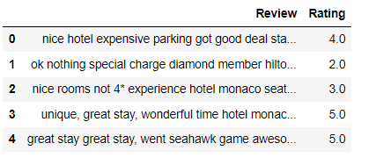
Analysis/Modeling methodology
Data preprocessing and EDA
Data Quality check
The dataset of “Hotel Reviews” consists of 20,491 rows and 2 columns.
In that, 1 variables are object variables and 1 variables numerical variables.
There are no affected variables in the data set.
There are no duplicate records or missing values in the dataset.
The rating column's mean is 3.952223, while the standard deviation is 1.23303.

Slide 5
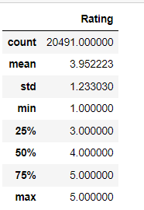
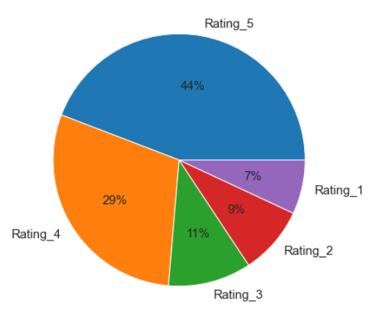
Analysis Results
Key Insights:
The relevant insight is the Rating.
We noticed that the hotel reviews had more Rating_5 compare to other ratings
Here as we see 4 and 5 rating are contributing nearly 75% which shows biased towards positive side.
The remaining Rating_1 and 2,3 has the least percentages.

Slide 6
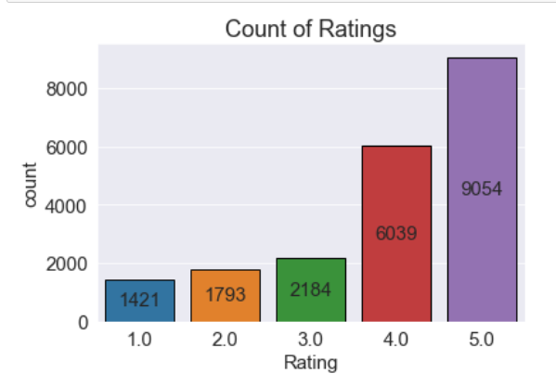
Bar graph:
Key Insights:
From the visual, we can say that count of ratings for 4, 5 are comparatively much higher than the other rating scores.
There are 1421 customers gave the lowest 1.0 star rating
There are 9054 customers gave the highest 5.0 star rating
Hence, we conclude that most of the users are highly satisfied with their experience at the hotels.

Slide 7
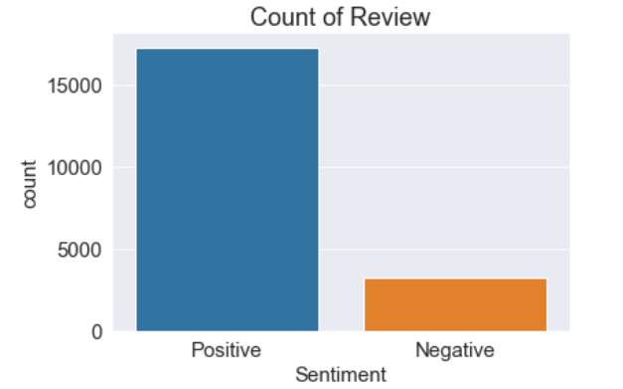
The positive and negative reviews:
Key Insights:
Ratings less than or equal to two are considered negative reviews, while ratings greater than two are considered positive.
For the visual, we can state that around 75% of the evaluations are positive, with the remaining 25% being negative.
We have an unbalanced distribution of data, with fewer negative ratings supplied by people. So we can classify the dataset as extremely unbalanced.

Slide 8
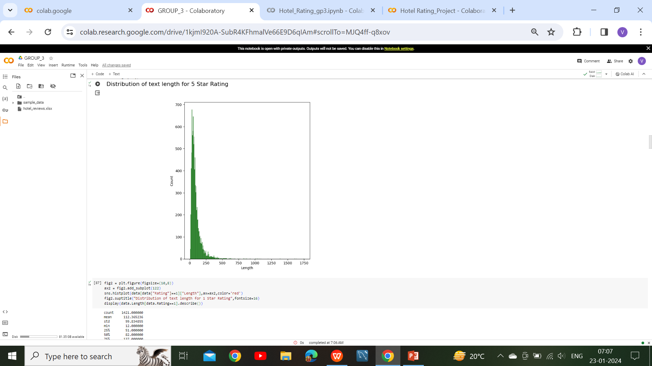
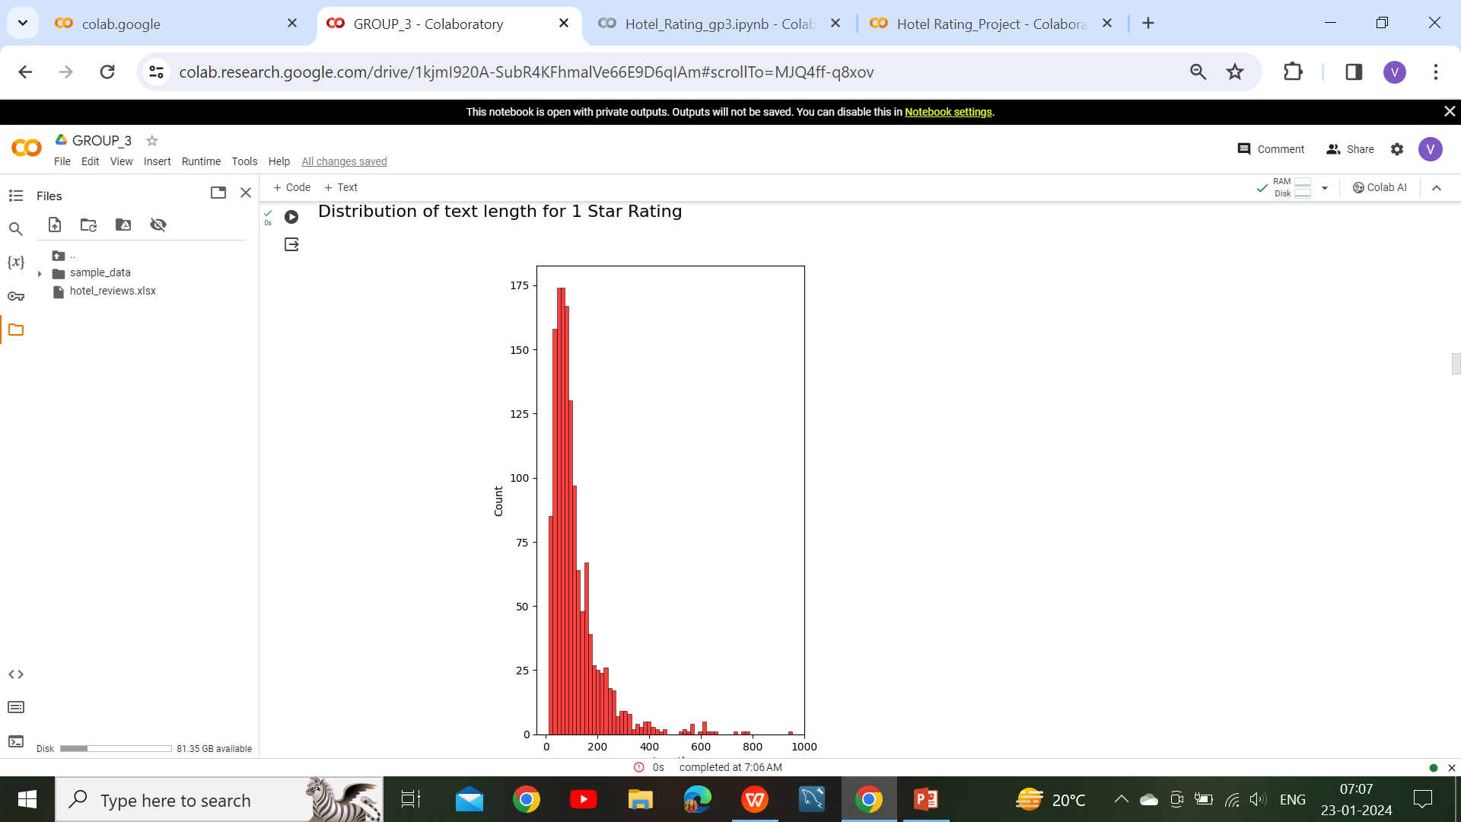

Review length for 5-level and 1-level ratings

Slide 9
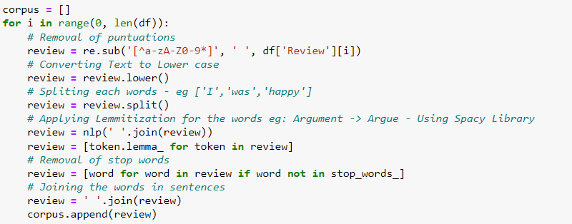
Data Preprocessing
STEPS FOR DATA CLEANING
Remove Punctuation
Case change
Tokenization
Removing stop words

Slide 10
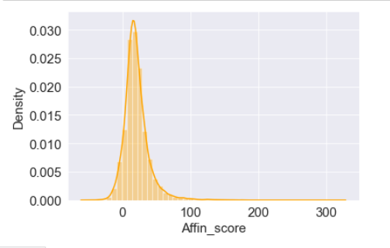
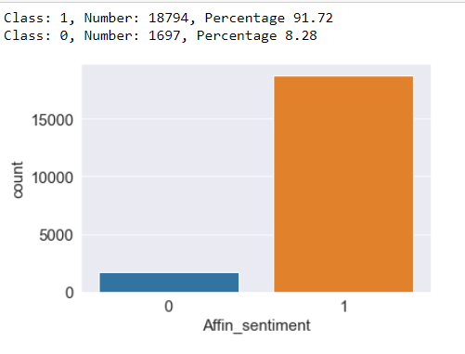
Afinn Sentiment Analysis
Key Insights:
The picture shows that there are more positive reviews than neutral and negative ones.
From above graph we can conclude our dataset is biased towards positive side and positive sentiment percentage is 91.72 and for negative sentiment percentage is 8.28
The negative class denotes 1,502 cases, or 7.33% of the total, that are characterized as having a negative sentiment.

Slide 11
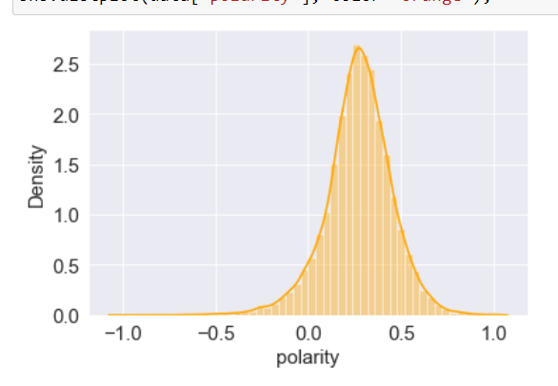
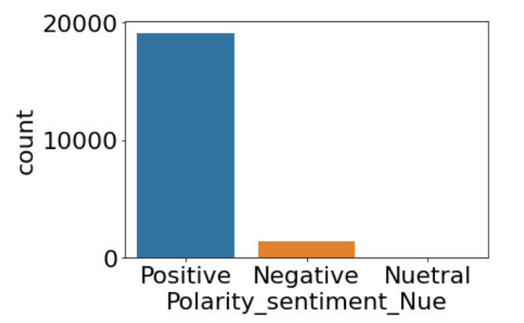
Polarity Sentiment Analysis
Key Insights:
We define less than 0 as negative, equal to 0 as neutral, and greater than 0 as positive reviews.
The picture indicates that there are more positive reviews than neutral and negative reviews.
Positive class indicates that 19150 instances in the dataset were identified as having a positive sentiment, accounting for 93.46% of the total.
The neutral class indicates 1323 instances with a neutral emotion, accounting for 6.46% of the total.
Negative class indicates that 18 instances are classed as having a negative sentiment, accounting for 0.09% of the total

Slide 12
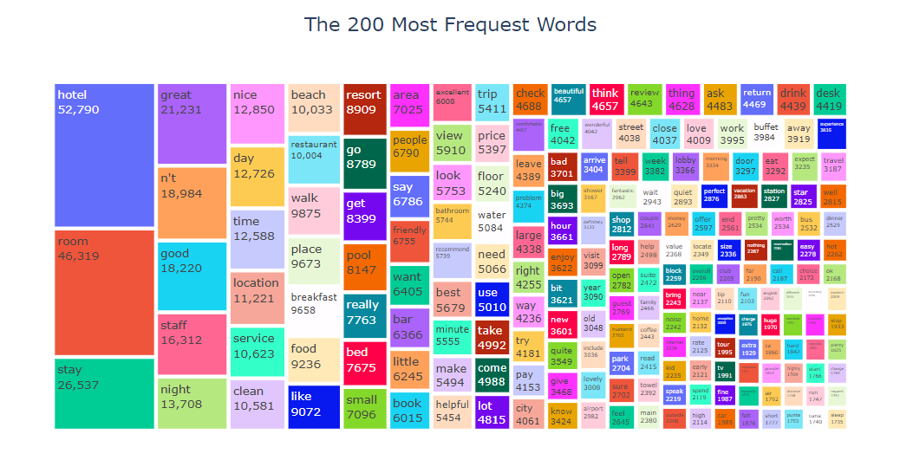
Data Visualization
Key Insights:
Based on the Tree map above, all of the words are unique words and there are no stop words in this set. Most words are 'hotel', 'room' and 'stay'. Due to the fact that we are dealing with a hotel review dataset, it make sense.

Slide 13
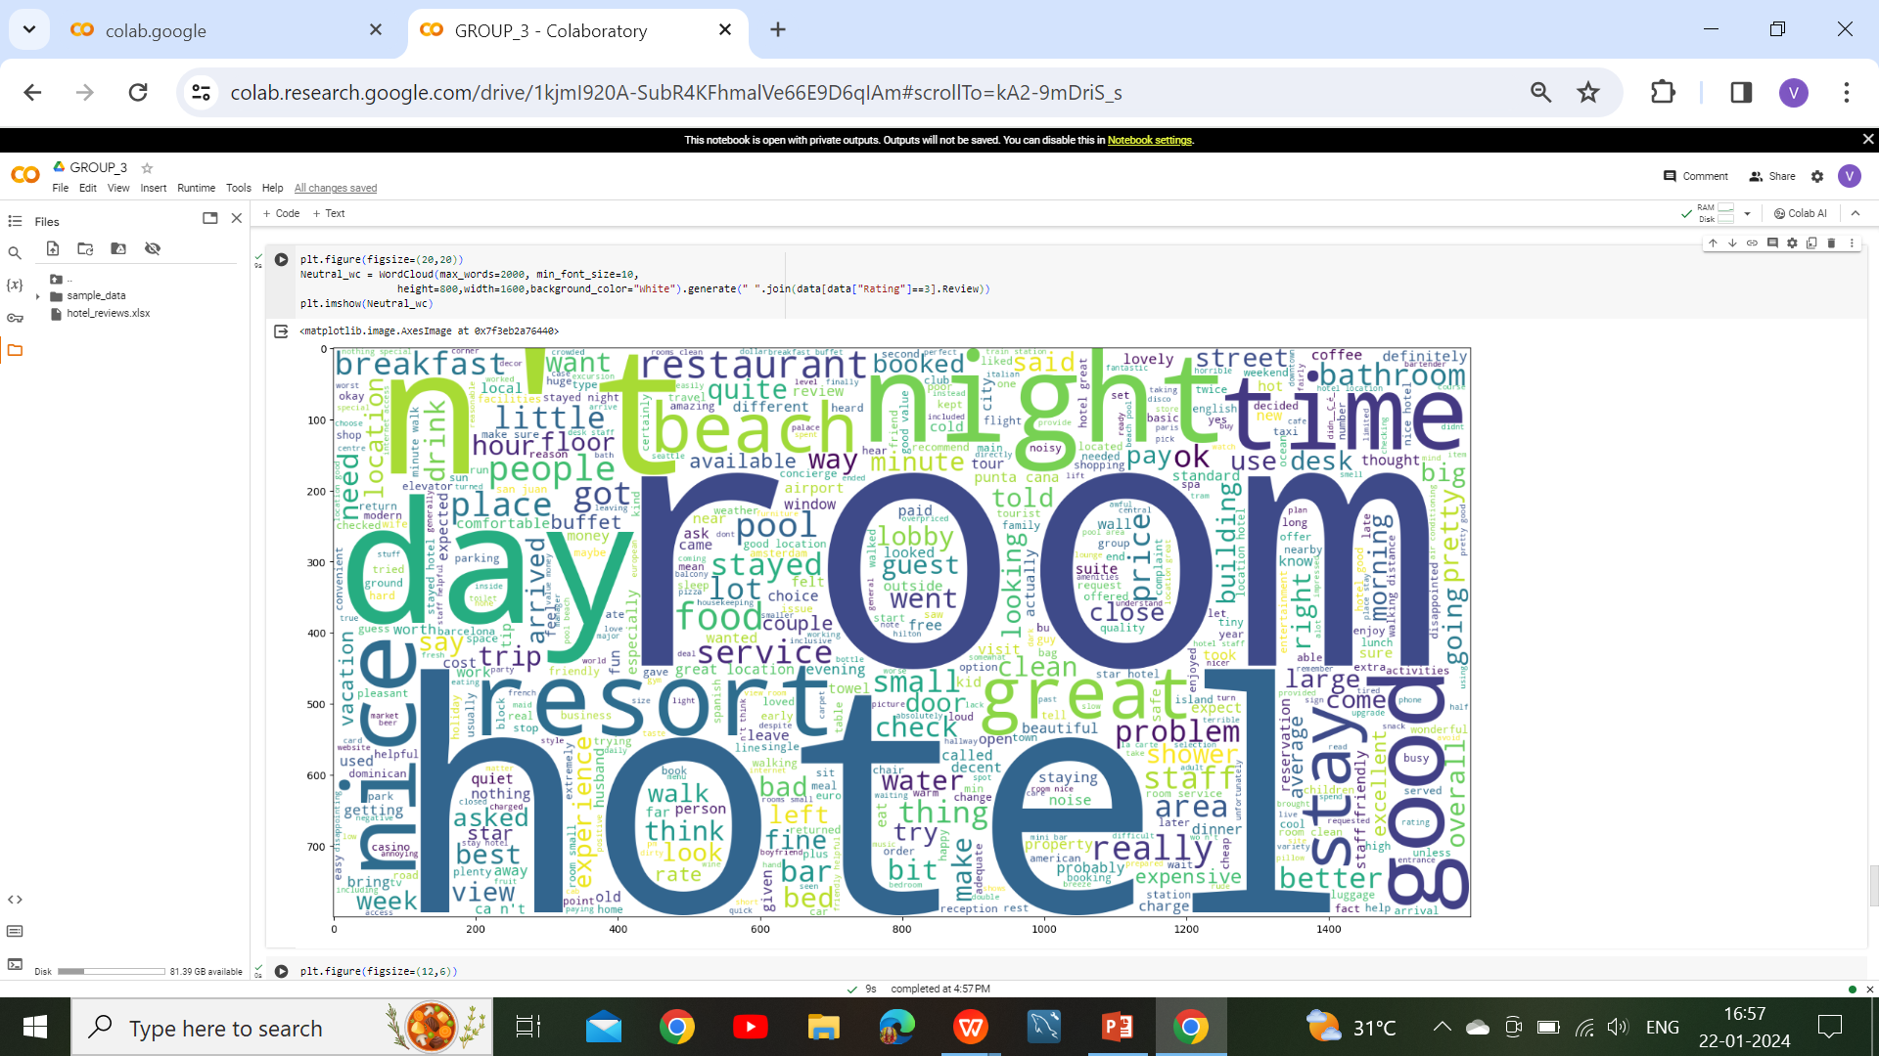
* POSITIVE WORDCLOUD *
Key Insights:
It represents the positive words present in the overall dataset.
Words like good , great, nice are most frequent words
Words like beautiful , recommend , excellent, better shows some of the good characteristics of hotels .

Slide 14
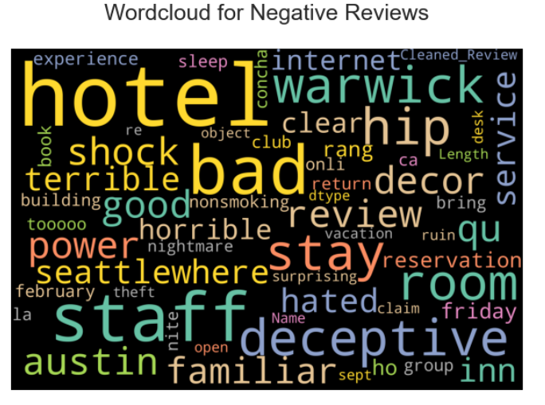
* NEGATIVE WORDCLOUD *
Key Insights:
It represents the negative words present in the overall dataset.
Words like problem, bad , hard, noise are most frequently used words.
Words like complaint , disappointed , terrible , horrible depicts the bad characteristics of the hotels

Slide 15
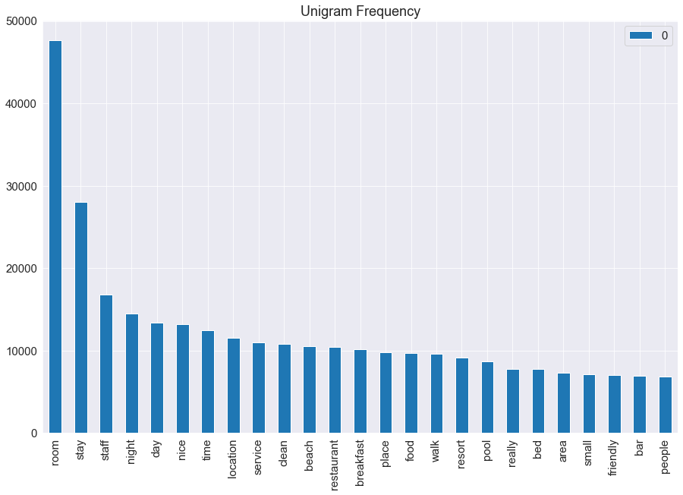
Term frequency with countvectorizer
Key Insights:
The top most 25 frequency analysis of single word reputation using term frequency with countvectorizer are room, stay, staff, night, day and etc.

Slide 16
BI-GRAMS
A bigram is a sequence of two adjacent elements from a string of tokens, which are typically letters, syllables, or words.
A bigram is an n-gram for n=2. The frequency distribution of every bigram in a string is commonly used for simple statistical analysis of text in many applications, including in computational linguistics, cryptography, speech recognition, and so on.
In next slide it can be seen that rating-1 reviews contains mostly ‘not’ like (not worth, not recommended, not good )pairs that can be describing bad characteristics about hotel.
Rating-3 reviews have good pairs of words about hotel characteristics, like(highly recommended, friendly helpful, place stay).
It can be seen that Rating-2 reviews have both positive and negative pairs, like(not good, not great, walking distance, minute walk, staff friendly).

Slide 17
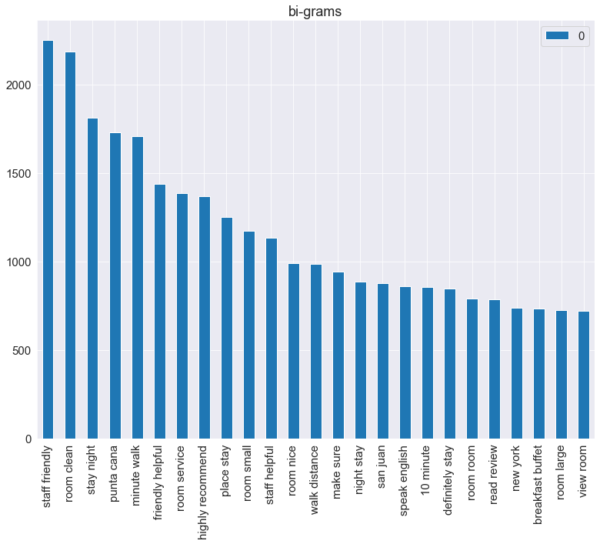
Key Insights:
In the Bigram Language Model, we find bigrams, which are two words coming together in the corpus like frequency with count vectorizer are staff friendly, room clean, room service and etc. (the entire collection of words/sentences).

Slide 18
TRI-GRAMS
Trigrams are a special case of the n-gram, where n is 3. They are often used in natural language processing for performing statistical analysis of texts and in cryptography for control and use of ciphers and codes.
Analyzing tri-grams we can collect more details about reviews on different ratings.
In Rating-2 reviews pairs like(not speak English, food not good, not worth money) clearly says the problems associated with hotels.
In Rating-3 reviews, pairs like(easy walking distance, great location, good value money)
Rating-2 reviews contains both positive and negative words
Some pairs can be seen both in Rating-3 and Rating-2 reviews like(free internet access, flat screen tv, staff friendly helpful)
Some pairs can be seen in all types of reviews like (king size bed, old san juan)

Slide 19
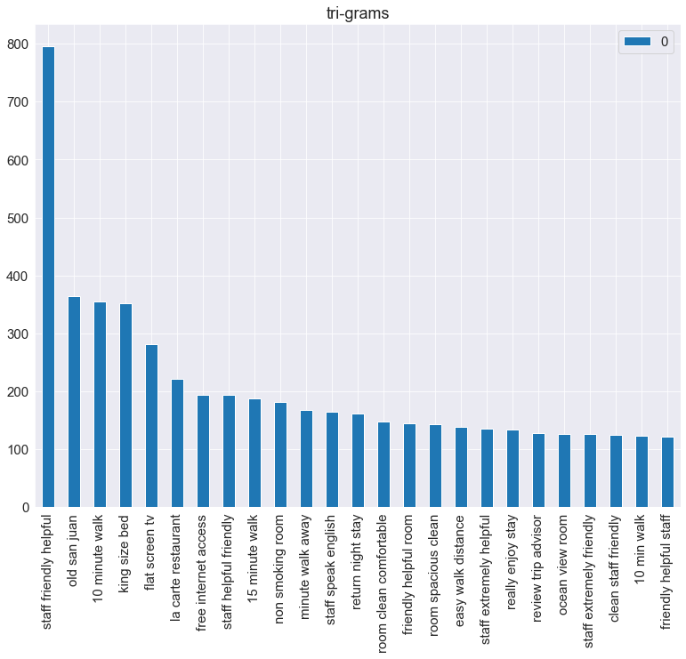
Key Insights:
In the Trigram model approximates the probability of a word given all the previous words by using only the conditional probability of the preceding words while a trigram model looks two words into the past.

Slide 20
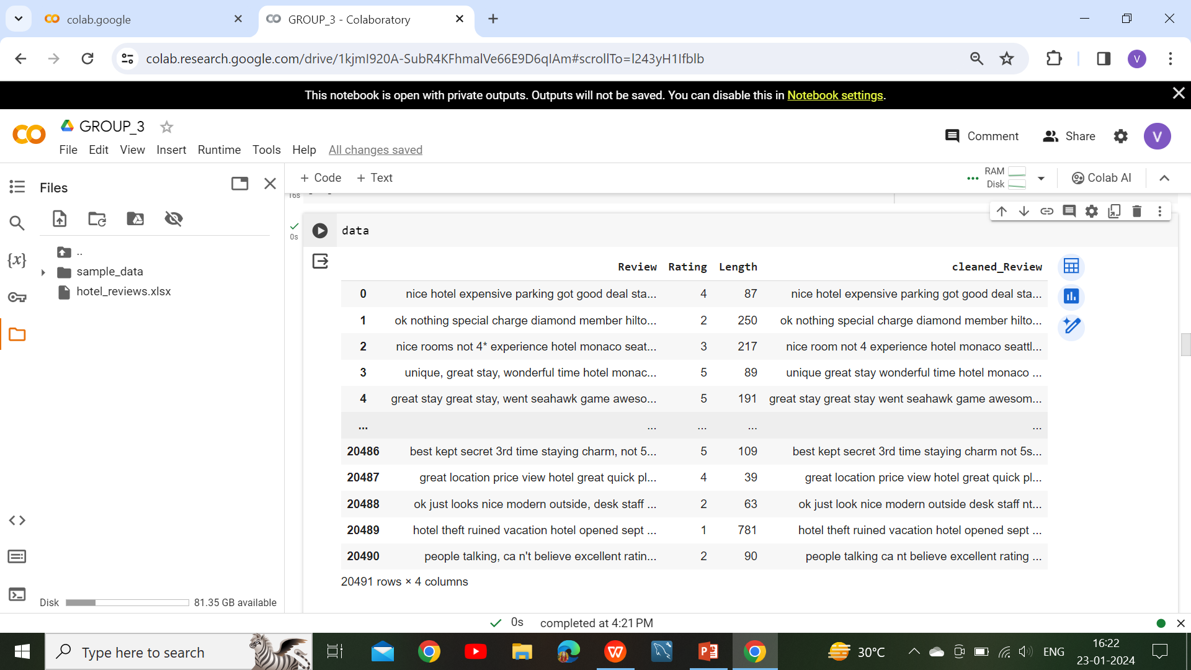
New ratings and Cleaned text used in further analysis

Slide 21
Feature extraction Using TFIDF
Feature extraction for machine learning and deep learning. Feature extraction refers to the process of transforming raw data into numerical features that can be processed while preserving the information in the original data set. It yields better results than applying machine learning directly to the raw data.
The concept TF-IDF stands for term frequency-inverse document frequency. This is in the field of numerical statistics. With this concept, we will be able to decide how important a word is to a given document in the present dataset or corpus.

Slide 22
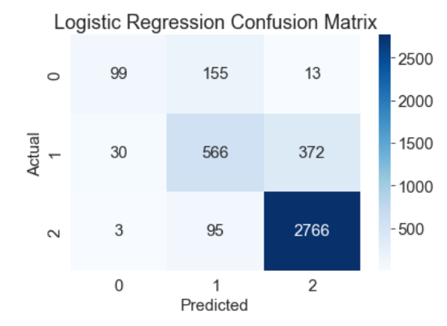
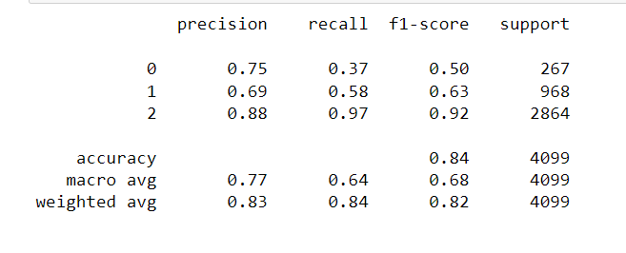
Model Building
Logistic Regression
Key Insights:
Logistic regression is used to describe data and the relationship between one dependent variable and one or more independent variables
The accuracy score using logistic regression is 0.8431 i.e., 84.31%.

Slide 23
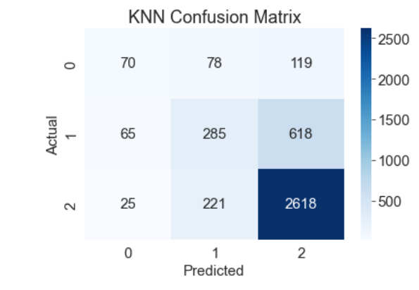
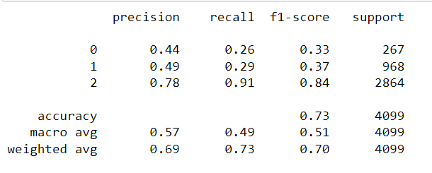
K-Nearest Neighbor(KNN)
Key Insights:
The k-nearest neighbors algorithm, also known as KNN or k-NN, is a non-parametric, supervised learning classifier, which uses proximity to make classifications or predictions about the grouping of an individual data point.
The accuracy score using K-Nearest Neighbor is is 0.7331 i.e., 73.31%.

Slide 24
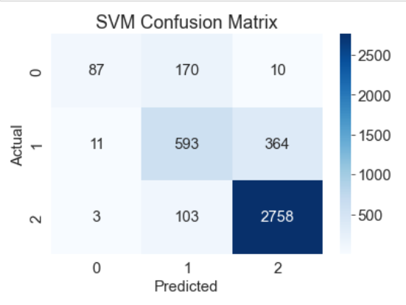
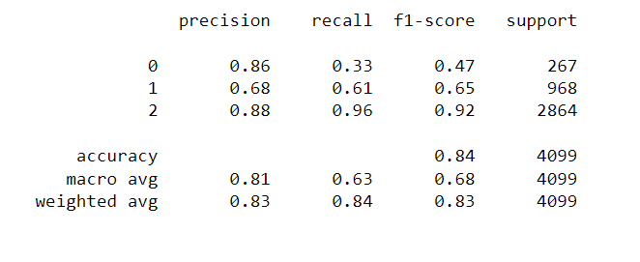
Support Vector Machine(SVM)
Key Insights:
The SVM kernel is a function that takes low dimensional input space and transforms it to a higher dimensional space
The accuracy score using Support Vector machine (SVM) is is 0.8487 i.e., 84.81%.

Slide 25
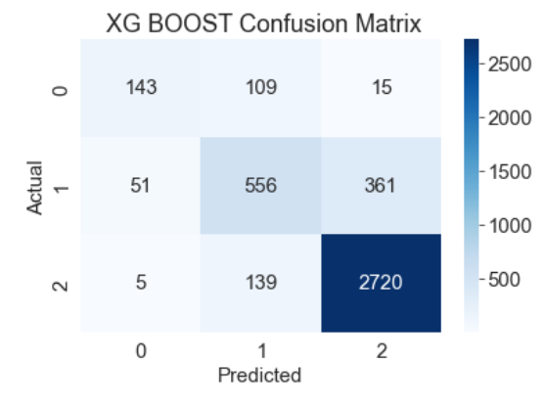
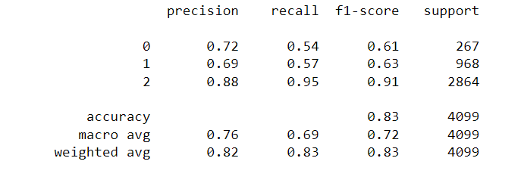
XG Boost(Gradient Boosting)
Key Insights:
XG Boost, which stands for Extreme Gradient Boosting, is a scalable, distributed gradient-boosted decision tree (GBDT) machine learning library
The accuracy score using Support Vector machine (SVM) is 0.8381 i.e., 83.81%.

Slide 26
Support Vector Machine(SVM)
Support Vector Machine (SVM) is a supervised machine learning algorithm that is used for classification and regression tasks. The primary goal of SVM is to find the optimal hyperplane in a high-dimensional space that separates data points of different classes with the maximum margin
Text and Document Classification: SVM is most effective in natural language processing tasks.
Advantages of SVM:
High-Dimensional Spaces: SVM works well in high-dimensional spaces.
Robust to Overfitting: SVM has good generalization capabilities, reducing the risk of overfitting.
Effective in Non-Linear Spaces: SVM can handle non-linear decision boundaries through kernel functions.
It Showcase real-world examples and case studies where SVM has been successfully applied.
For text classiﬁcation, we are have performed data-preprocessing that is we have already selected the features that contributes most for the sentiment analysis.
The SVM kernel is a function that takes low dimensional input space and transforms it to a higher dimensional space
The accuracy score using Support Vector machine (SVM) is is 0.8487 i.e., 84.81%.

Slide 27
Challenges and Difficulties:
During the Data Cleaning process we have faced that there was so many wrong spelling words, punctuations and stop words in the data.
While Choosing the right classification algorithm for the model Evaluation ,as we required the experimentation on the different models.
For the Better accuracy Score we performed the boosting techniques also in the model building.
We also performed Some complex models, like neural networks, might lack interpretability, making it difficult to understand their decision-making process.
Despite using Vader in Sentiment analysis we had to had to do research on other Sentiment Analysis like Text blob, Affin score .
Due to Inexperience in the Deploying the model into a real-world environment can present integration and maintenance challenges.
As we Ensuring the model remains relevant as new data becomes available or as user preferences change.

Slide 28
DEPLOYMENT USING STREAMLIT
We have developed a Machine Learning model for Hotel analysis using Streamlit
Why Streamlit:
so we choose Streamlit for deployment. Highlight its simplicity, ease of use.
Ability to turn data scripts into shareable web apps with just a few lines of code.
Installed Streamlit using Tool like pip: ‘pip install streamlit’
Web Link:https://p339-group3-hotel-reviews-sentiment-prediction.streamlit.app/

Slide 29
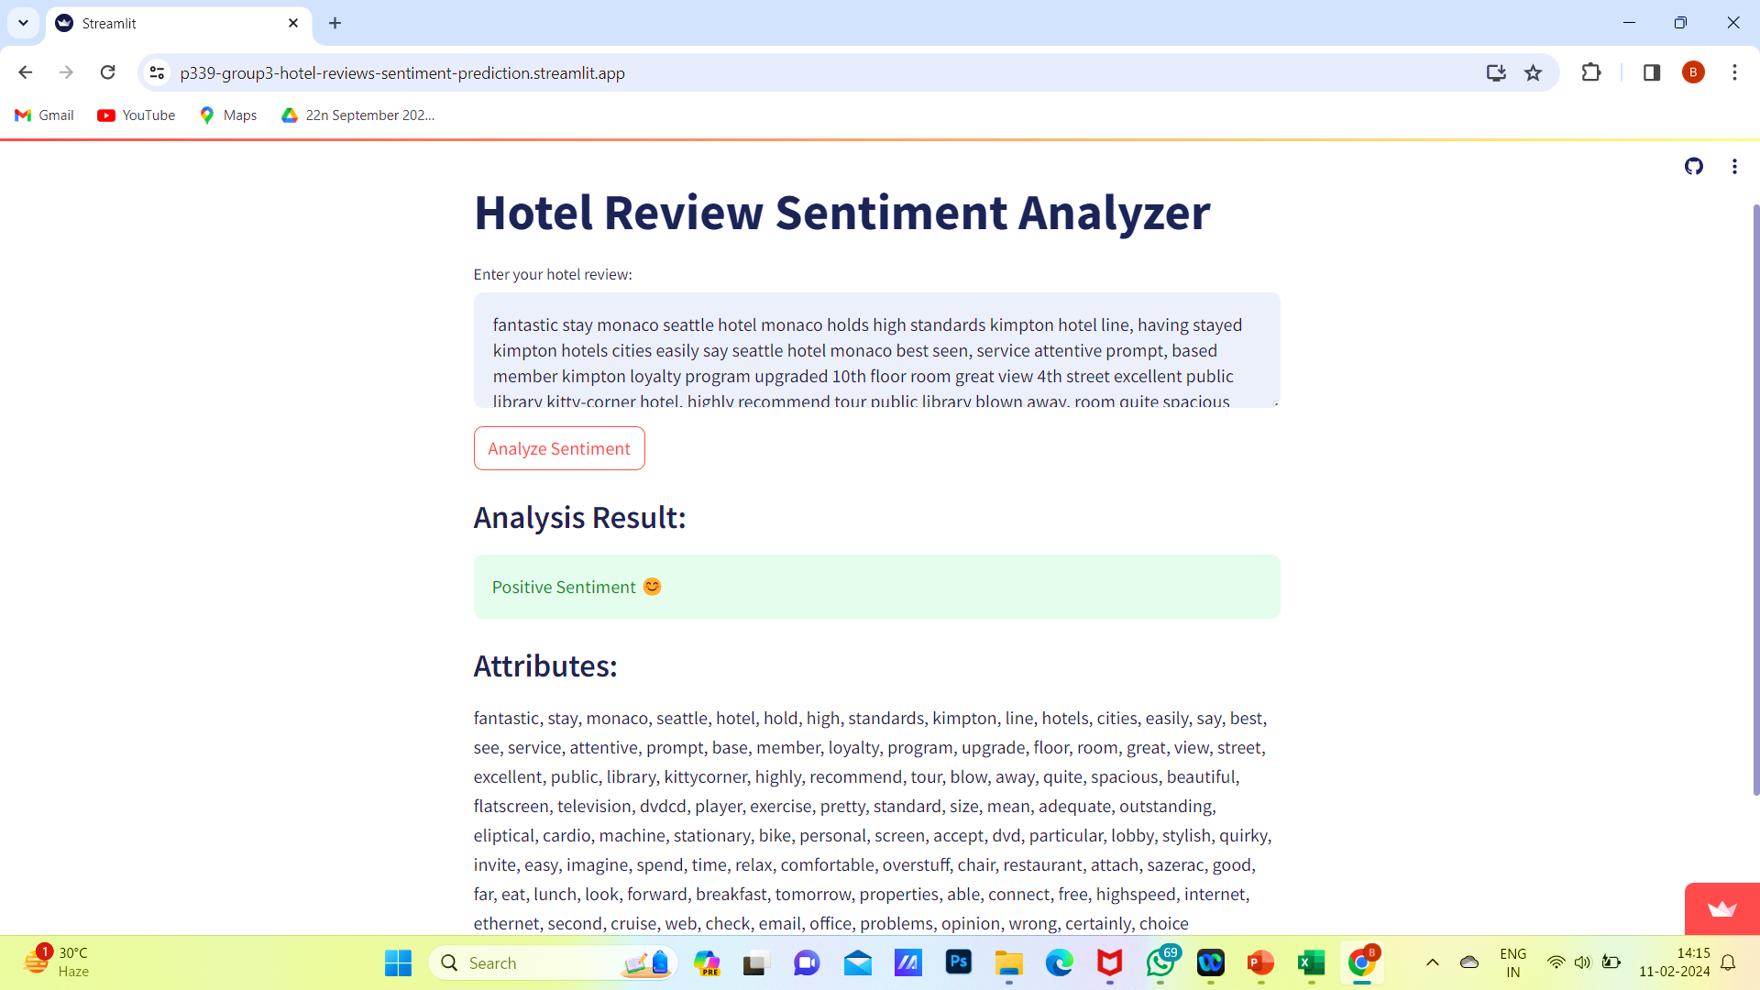
Positive Sentiment

Slide 30
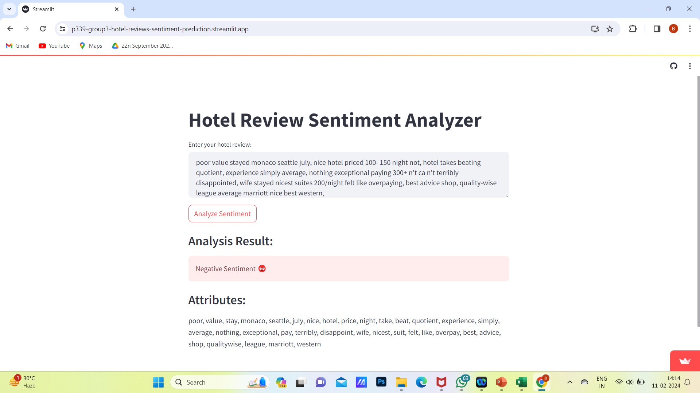
Negative Sentiment

Slide 31


Slide 32


